Slide 1



Compact Hashing for Mixed Image-Keyword Query over Multi-Label Images
Xianglong Liu¹, Yadong Mu², Bo Lang¹ and Shih-Fu Chang²
¹Beihang University, Beijing, China
²Columbia University, New York, USA

Slide 2
Outline
Introduction
Motivation
Our Solution
Boosted Shared Hashing
Formulation
Optimization
The Retrieval Stage
Experiments
Conclusion

Slide 3
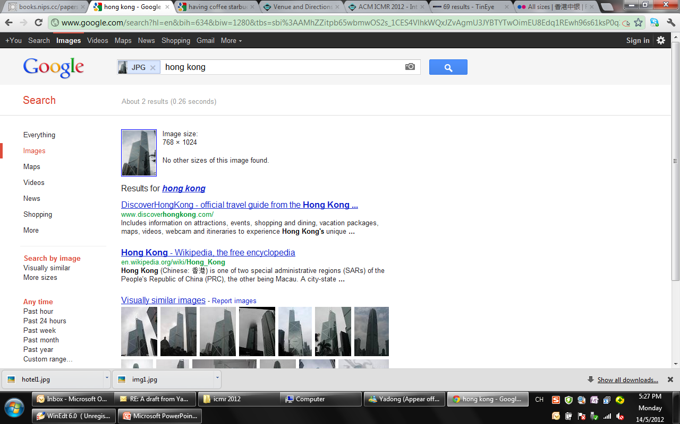
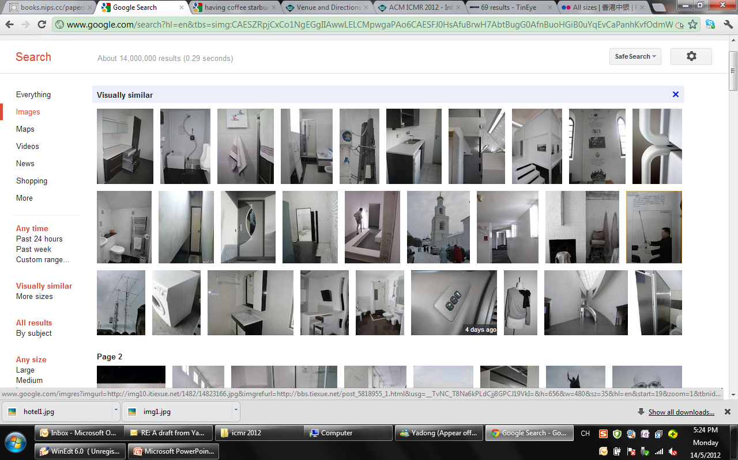
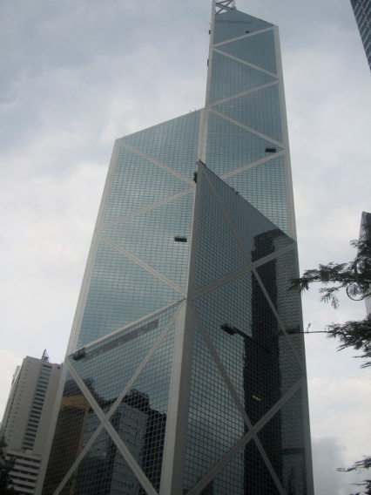
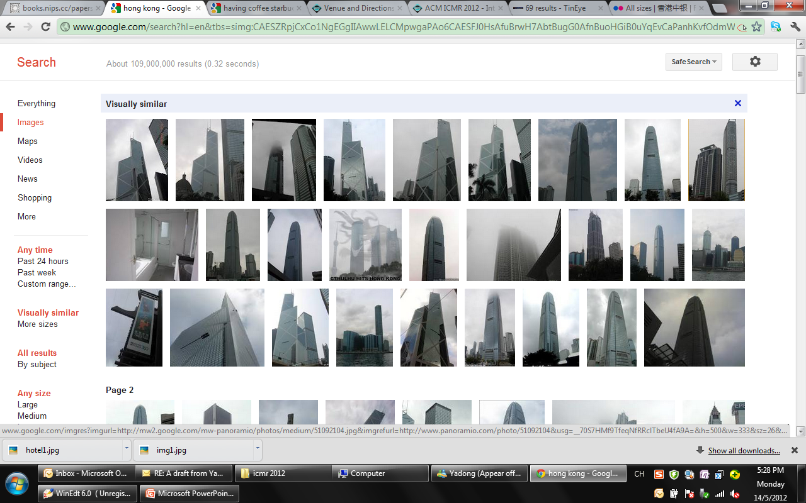
“Image + Keyword” based Visual Search (1/4)
Yet another image search paradigm
Query image provides content descriptor
Textual keywords greatly narrow the semantic gap!
Query Image
Search-By-Example Results on Page #1
Notes:
http://farm7.staticflickr.com/6017/5981125420_fc7521c93a_b.jpg

Slide 4
“Image + Keyword” based Visual Search (2/4)
Challenge-1: Noisy or unknown label information
Database Images: labels are unknown and expensive to annotate
Training Images: a small set, and manually annotated
Query: Image + Keyword (or label)
Problem Settings
 | Visual Features | Labels
Database
Training Set
Query
√
√
√
√
√

Slide 5
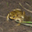


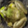





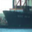
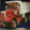

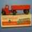
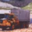
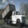
“Image + Keyword” based Visual Search (3/4)
Challenge-2: Scalability to Web-Scale Data
Linear scan is infeasible
Approximate nearest neighbor (ANN)
balance the performance and computational complexity
Tree-based methods (KD tree, metric tree, ball tree, etc. )
Hashing-based methods: efficient index and search
Hashing
Hashing Tables
Bucket
Indexed Image
w_{k}
0010…
0/-1
1
0110…
…
…
1111…

Slide 6
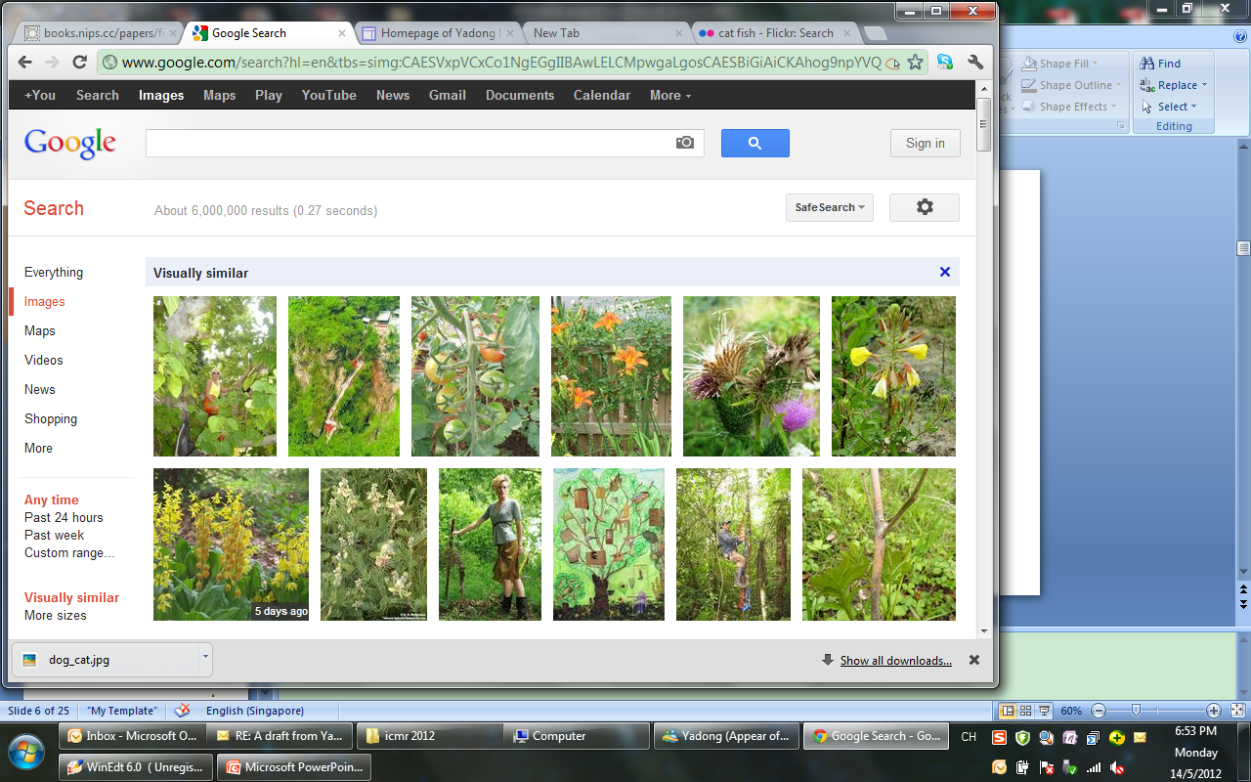
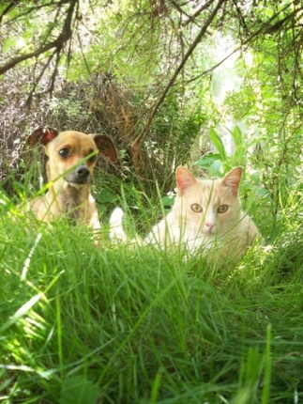
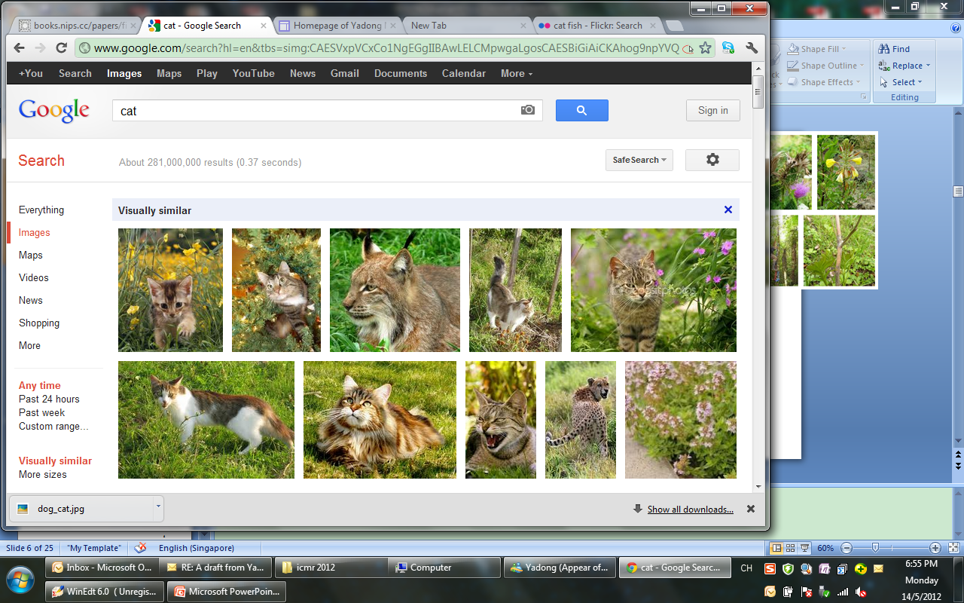
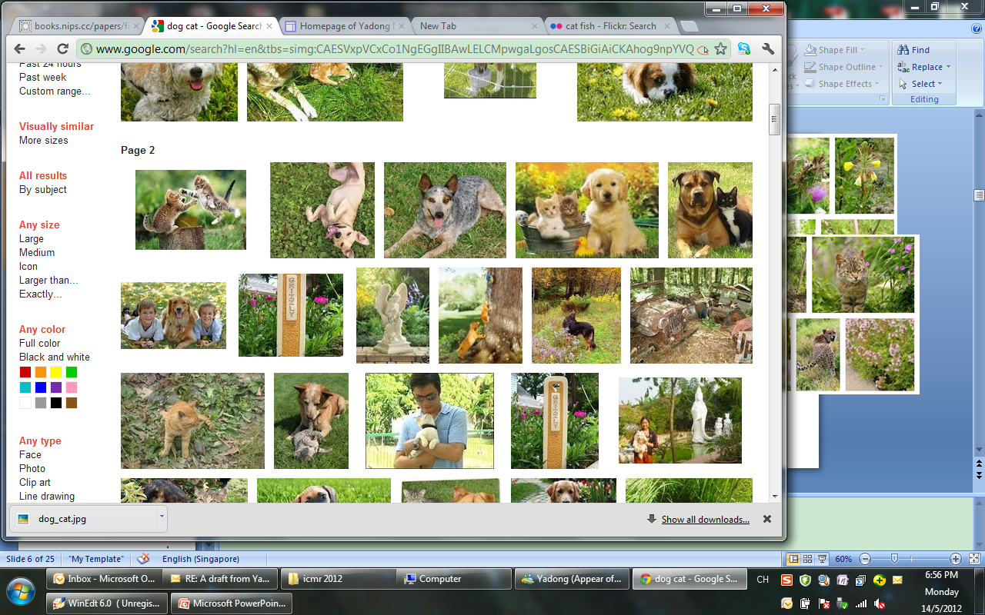
“Image + Keyword” based Visual Search (4/4)
Challenge-3: Diverse Semantics
User intention is ambiguous / diverse
Query-adaptive hashing over multi-label data
Query Image
Keywords
Top Results
Cat
Dog+Cat

Slide 7
Related Works
Supervised Hashing
Naïve solutions for Hashing with Multi-Label Data
Universal hash function:
Semi-Supervised Hash [Wang10a]
Sequential Projection Hash [Wang10b]
Universal ones: hard to learn
Complicate bit selection
Per-Label hash function:
Bit-Selection Hash [Mu 11]
Redundancy

Slide 8
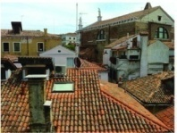
Overview of Our Solution (1/2)
Key idea: to encourage sparse association between hashing functions and labels by exploiting shared subspaces among the labels
Hashing functions
Bit-label association
Query
Select optimal hash bits per query
Image
1
2
1
2
3
4
1
2
√
√
√
√
3
√
4
√
labels
3
denotes samples associated with both and

Slide 9
Overview of Our Solution (2/2)
Training Data
Boosted Shared Hashing
Database Data
Labels
Visual Features
Visual Features
Indexed
Database
Hash Functions
Bit-Label Association Matrix
Query
Labels
Visual Features
Selected Bits
Output
Ranked
Images

Slide 10
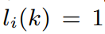
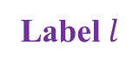
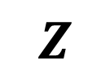
Data Structure
Multi-label data
: x_{i} is associated with the k-th label
Neighbor graph
homogeneous neighbors: with the same label
heterogeneous neighbors: with different labels
x
Label
Label
x₁
x₂
x₃
x₄
x₅
x₆
x₇
…
…
x_{l1}
x_{l2}
x
x
x_{l3}
…
= 1
= -1
= 0
Homogeneous Neighbors
Heterogeneous Neighbors
Notes:
I will explain the multi-view graph

Slide 11
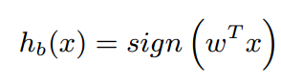
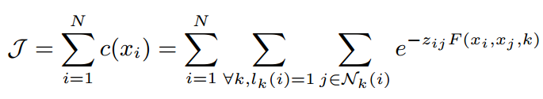
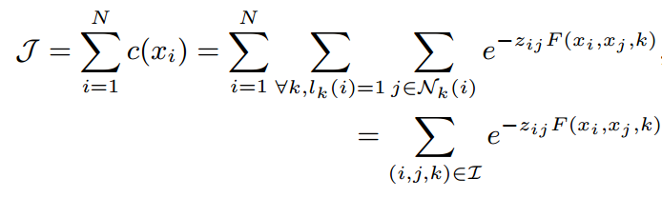
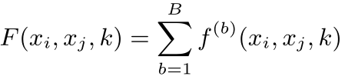
Objective Function
Encourage prediction f of hashing function h on neighbor pairs to have the same sign with neighbor matrix Z :
Homogeneous: z_{ij}=1, expect h_{b}(x_{i}) h_{b}(x_{j})=1
z_{ij} f(x_{i},x_{j},k)=1
Heterogeneous: z_{ij}=-1, expect h_{b}(x_{i}) h_{b}(x_{j})=-1
Hashing function
Exponential Loss Function:
Hashing prediction
Active Label Set
S(b): labels associated with the b-th bit

Slide 12
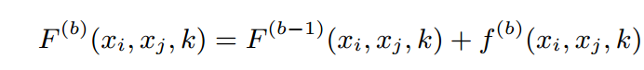
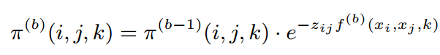
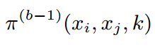
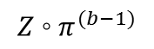
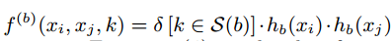
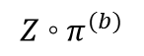
Sequential Learning: Boosting
Boosting style: to learn a hashing function that tries to correct the previous mistakes by updating weights on neighbor pairs
weights
prediction error
x₁
x₂
x₃
x₄
x₅
x₆
x₇
…
x₁
x₂
x₃
x₄
x₅
x₆
x₇
…
x₁
x₂
x₃
x₄
x₅
x₆
x₇
…
…
…
…
x_{l1}
x_{l1}
x_{l1}
x_{l2}
x_{l2}
x_{l2}
x_{l3}
x_{l3}
x_{l3}
…
…
…
> 0
< 0
= 0

Slide 13
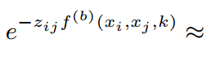
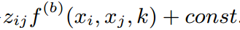
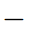
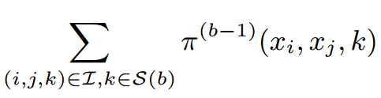
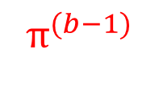
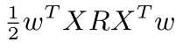
Optimize: hashing function
Taylor expansion
x₁
x₂
x₃
x₄
x₅
x₆
x₇
…
= 1
= -1
= 0
…
x_{l1}
√
╳
√
-
x_{l2}
√
√
x_{l3}
╳
√
√
╳
╳
Relaxation of sign function
efficiently solved by eigen-decomposition

Slide 14
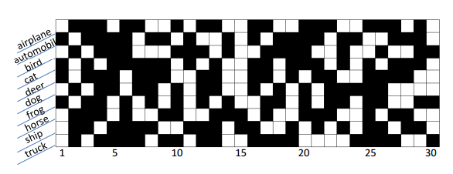
Optimize: active label set
Find a label subset S(b) that gives minimum loss
Intuitive way: exhaustively compare all possible 2^{L} subsets
A greedy selection O(L²):
Initialize S(b): the label giving minimum loss;
Expand S(b): add label giving the most loss decrease among all rest labels
Terminated when the gain is incremental (<5%)
Association matrix on CIFAR-10

Slide 15
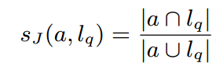
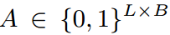
Query-Adaptive Search
Bit selection based on matching-score
Select bits that are most confident across all query labels 𝑙_{𝑞}
Measured by Jaccard index: computed between a (any column of matrix A) and query labels 𝑙_{𝑞}:
is the learned bit-label association matrix
...
h_{i}
h_{j}
h_{k}
cat
dog
Association matrix on CIFAR-10

Slide 16
Experiments
Datasets
Multi-category: CIFAR-10 (60K)
Multi-label: NUS-WIDE (270K)
Baselines:
SPLH [Wang 10a], SH [Weiss 08], and LSH [Indyk 98]
Setting:
15 homogeneous and 30 heterogeneous neighbors without tuning.
same # bits per query for all methods
Average performance of 10 independent runs

Slide 17
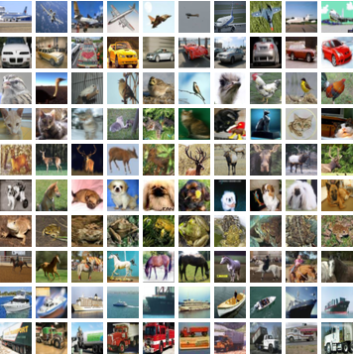
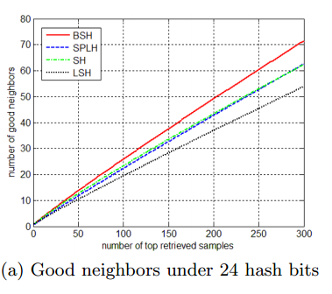
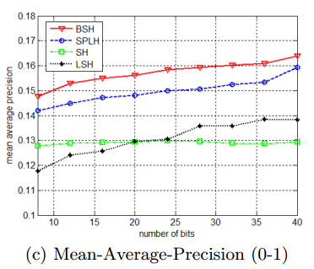
CIFAR-10
32x32 color images, 10 semantic categories (e.g., airplane, frog, truck etc.)
3,000 images as training data
1,000 random samples as the queries
384-D GIST features

Slide 18
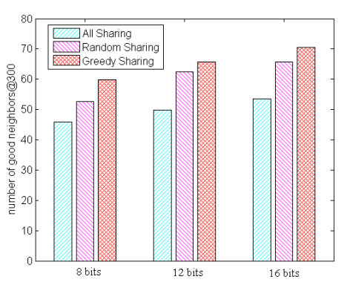
Impact of Sharing
Greedy sharing: S(b)
All sharing: each hashing function is universal for all labels
Random sharing: uniformly sample specific number (the averaged size of S(b)) of labels to be active

Slide 19
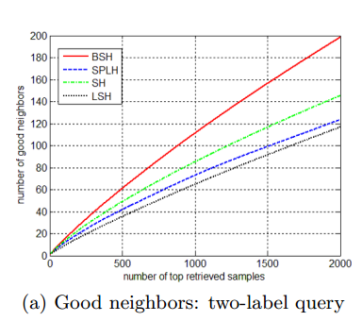
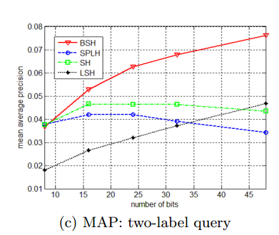
NUS-WIDE
Select 25 most-frequent tags (“sky”, “clouds”, “person”, etc.) from 81 tags
5,000 images as training set
1,000 images with two randomly selected labels as the query set
Groundtruth for each query: images with both (1) the same labels; and (2) the closest distances of their visual features
Concatenate 500-D Bow (SIFT) and 225-D block-wise color moment

Slide 20
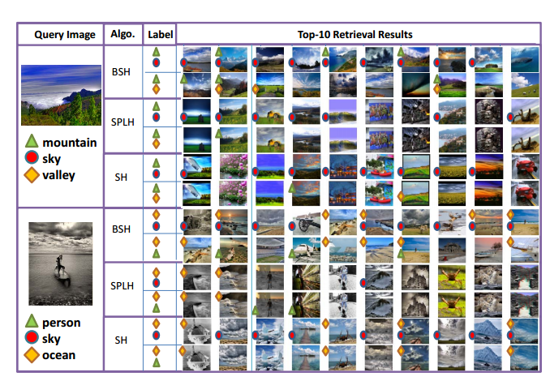
Examples

Slide 21
Summary and Conclusion
Summary and contributions
the first compact hashing technique for mixed image-keyword search over multi-label images
an efficient Boosting-style algorithm to sequentially learn the hashing functions and active label set for multi-label images
A simple hashing function selection adaptive to query labels
Future work
Theoretical analysis of performance guarantee
Extension to non-linear and reweighted hashing

Slide 22


Thank you!

Slide 23
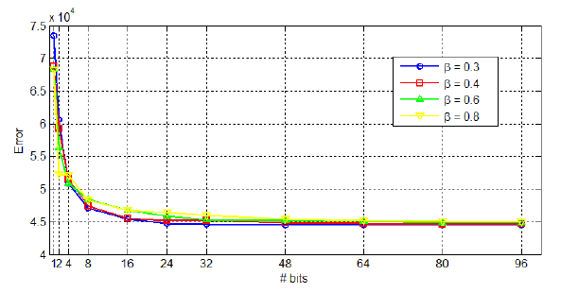
Convergency

Slide 24
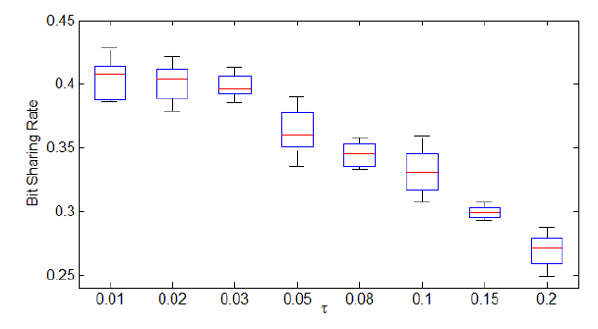
Sharing Rate

